Slide 1
MAERSK LINE container management system
Marcus lee tzyy min
Tp038611
uc3F1706SE
CT071-3-3-DDAC

Slide 2
Design Consideration
Container management system
Azure credit is provided
System will be used via devices with different screen size

Slide 3
Use Case

Slide 4

Cloud Architectural Diagram

Slide 5
System Development
PHP
HTML
CSS
MySQL
XAMPP
mySql workbench

Slide 6
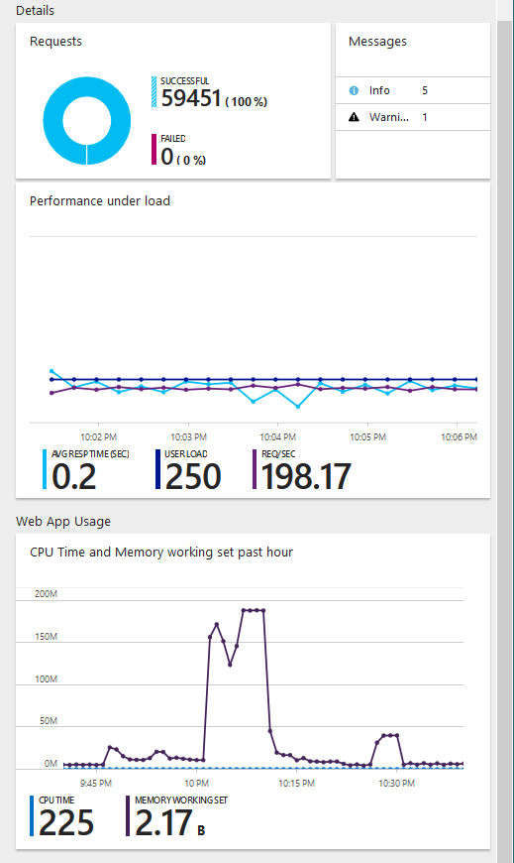
Performance testing

Slide 7
System demonstration

